Slide 1



MYSQL
Present by Eduwork.id
www.eduwork.id

Slide 2


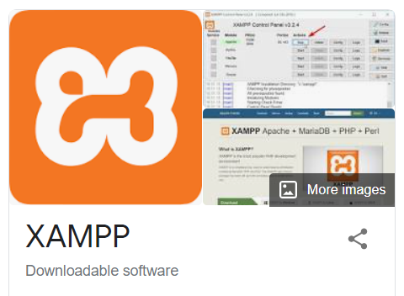
www.eduwork.id | Page 01
MYSQL
Deskripsi
MySQL adalah sebuah DBMS (Database Management System) menggunakan perintah SQL (Structured Query Language) yang banyak digunakan saat ini dalam pembuatan aplikasi berbasis website.
Manfaat
Secara garis besar, fungsi dari MySQL adalah untuk membuat dan mengelola database pada sisi server yang memuat berbagai informasi dengan menggunakan bahasa SQL.
Aplikasi yang dibutuhkan

Slide 3
www.eduwork.id | Page 01
Referensi Belajar
https://www.youtube.com/watch?v=fxe6qev-bno
https://www.youtube.com/watch?v=xYBclb-sYQ4
https://www.duniailkom.com/tutorial-belajar-mysql-dan-index-artikel-mysql

Slide 4
TYPE DATA DAN PRIMARY KEY
Present by Eduwork.id
www.eduwork.id

Slide 5
www.eduwork.id | Page 05
String Data Types
https://www.w3schools.com/sql/sql_datatypes.asp
CHAR(size) | A FIXED length string (can contain letters, numbers, and special characters). The size parameter specifies the column length in characters - can be from 0 to 255. Default is 1
VARCHAR(size) | A VARIABLE length string (can contain letters, numbers, and special characters). The size parameter specifies the maximum column length in characters - can be from 0 to 65535
BINARY(size) | Equal to CHAR(), but stores binary byte strings. The size parameter specifies the column length in bytes. Default is 1
VARBINARY(size) | Equal to VARCHAR(), but stores binary byte strings. The size parameter specifies the maximum column length in bytes.
TINYBLOB | For BLOBs (Binary Large Objects). Max length: 255 bytes
TINYTEXT | Holds a string with a maximum length of 255 characters

Slide 6
www.eduwork.id | Page 05
Numeric Data Types
https://www.w3schools.com/sql/sql_datatypes.asp
BIT(size) | A bit-value type. The number of bits per value is specified in size. The size parameter can hold a value from 1 to 64. The default value for size is 1.
TINYINT(size) | A very small integer. Signed range is from -128 to 127. Unsigned range is from 0 to 255. The size parameter specifies the maximum display width (which is 255)
BOOL | Zero is considered as false, nonzero values are considered as true.
BOOLEAN | Equal to BOOL
SMALLINT(size) | A small integer. Signed range is from -32768 to 32767. Unsigned range is from 0 to 65535. The size parameter specifies the maximum display width (which is 255)
MEDIUMINT(size) | A medium integer. Signed range is from -8388608 to 8388607. Unsigned range is from 0 to 16777215. The size parameter specifies the maximum display width (which is 255)

Slide 7
www.eduwork.id | Page 05
Date and Time Data Types
https://www.w3schools.com/sql/sql_datatypes.asp
DATE | A date. Format: YYYY-MM-DD. The supported range is from '1000-01-01' to '9999-12-31'
DATETIME(fsp) | A date and time combination. Format: YYYY-MM-DD hh:mm:ss. The supported range is from '1000-01-01 00:00:00' to '9999-12-31 23:59:59'.
TIMESTAMP(fsp) | A timestamp. TIMESTAMP values are stored as the number of seconds since the Unix epoch ('1970-01-01 00:00:00' UTC). Format: YYYY-MM-DD hh:mm:ss.
TIME(fsp) | A time. Format: hh:mm:ss. The supported range is from '-838:59:59' to '838:59:59'
YEAR | A year in four-digit format. Values allowed in four-digit format: 1901 to 2155, and 0000. MySQL 8.0 does not support year in two-digit format.
DATE | A date. Format: YYYY-MM-DD. The supported range is from '1000-01-01' to '9999-12-31'

Slide 8
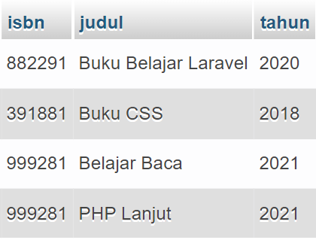
www.eduwork.id | Page 05
Primary Key
Primary key adalah suatu nilai dalam basis data yang digunakan untuk mengidentifikasi suatu baris dalam tabel. Nilai dari primary key adalah unik.
sedangkan secara sederhananya, primary key dapat diartikan sebagai kolom yang berisi nilai unik, berfungsi sebagai identitas untuk membedakan setiap record yang ada pada tabel.

